Slide 1
Effective Multi-Label Active Learning for Text Classification
Bishan yang, Juan-Tao Sun, Tengjiao Wang, Zheng Chen
KDD’ 09
Supervisor: Koh Jia-Ling
Presenter: Nonhlanhla Shongwe
Date: 16-08-2010

Slide 2
Preview
Introduction
Optimization framework
Experiment
Results
Summary

Slide 3
Introduction
Text data has become a major information source in our daily life
Text classification to better organize text data like
  Document filtering
  Email classification
  Web search
Text classification tasks are multi-labeled
  Each document can belong to more than one category

Slide 4

Introduction cont’s
Example
World news
Category
Politics
Education

Slide 5
Introduction cont’s
Supervised learning
  Trained on randomly labeled data
  Requires
    Sufficient amount of labeled data
  Labeling
    Time consuming
    Expensive process done by domain expects
Active learning
  Reduce labeling cost

Slide 6


Introduction cont’s
How does an active learner works?
Data Pool
Train
classifier
Select an optimal set
Selection strategy
Augment the labeled set Dl
Query for true labels

Slide 7
Introduction cont’s
Challenges for Multi-label Active Learning
  How to select the most informative multi-labeled data?
  Can we use single label selection strategy? NO
Example:
x1
0.8
0.5
0.1
c1
c2
c3
0.7
0.1
0.1
x2
c1
c2
c3

Slide 8





Optimization framework
Goal
  To label data which can help maximize the reduction of the expected loss
Description | Symbol
Input distribution
Training set
Prediction function given a training set
Predicted label set x
Estimated loss
Unlabeled data | or

Slide 9






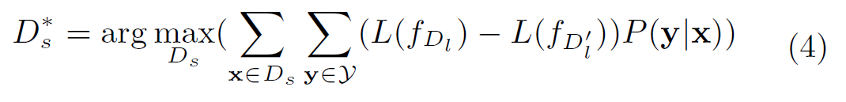
Optimization framework cont’s
If belongs to class j
E
E
p(x)

Slide 10
Optimization framework cont’s
Optimization problem can be divided into two parts
  How to measure the loss reduction
  How to provide a good probability estimation
Probability estimation
Loss reduction

Slide 11
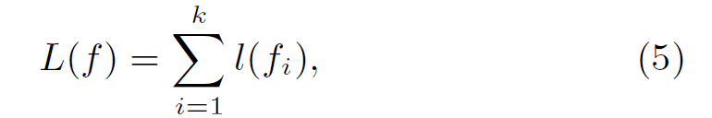
Optimization framework cont’s
  How to measure the loss reduction?
    Loss of the classifier
    Measure the model loss by the size of version space of a binary SVM
  Where W denotes the parameter space. The size of the version space is defined as the surface area of the hypersphere ||W|| = 1 in W

Slide 12
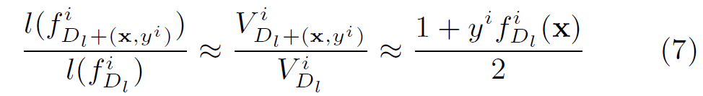




Optimization framework cont’s
How to measure the loss reduction?
  With version space, the loss reduction rate can be approximated by using the SVM output margin
 | Loss on binary classifier built on Dl associated with class i
 | Size of the version space for classifier
 | If x belongs to class i , then y = 1 otherwise y = -1

Slide 13
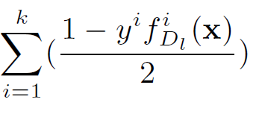
Optimization framework cont’s
How to measure the loss reduction?
  Maximize the sum of the loss reduction of all binary classifiers
  if f is correctly predict x
  Then |f(x)| uncertainty
  If f does not correctly predict x
  Then |f(x)| uncertainty

Slide 14
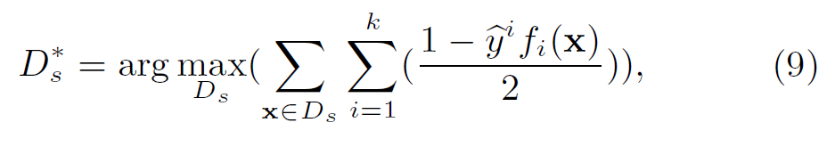

Optimization framework cont’s
How to provide a good probability estimation
  Intractable to directly compute the expected loss function
    Limited training data
    Large number of possible label vectors
  Approximate by the loss function with the largest conditional probability
      Label vector with the largest conditional probability

Slide 15
Optimization framework cont’s
How to provide a good probability estimation
  Predicting approach to address this problem
    Try to decide the possible label number for each data
    Determine the final labels based on the results of the probability on each label

Slide 16
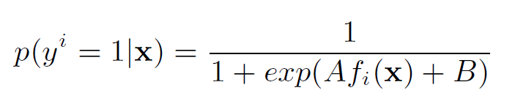

Optimization framework cont’s
  How to provide a good probability estimation
Assign probability output for each class
For each x, sort them in decreasing order and normalize the classification probabilities, make the sum = 1
For each unlabeled data, predict the probabilities of having different number of labels
Train logistic regression classifier
Features:
Label: the true label number of x
If the label number with the largest probability is j, then

Slide 17
Experiment
Data set used
  RCV1-V2 text data set [ D. D. Lewis 04]
    Contained 3 000 documents falling into 101 categories
  Yahoo webpage's collection through hyperlinks
Data set | # Instance | # Feature | # Label
Arts & Humanities | 3 000 | 47 236 | 101
Business & Economy | 3 711 | 23 146 | 26
Computers & Internet | 5 709 | 21 924 | 30
Education | 6 269 | 34 096 | 33
Entertainment | 6 355 | 32 001 | 21
Health | 4 556 | 30 605 | 32

Slide 18
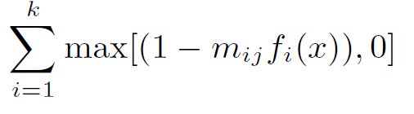

Experiment cont’s
Comparing methods
Name of method | description
MMC ( Maximum loss reduction with Maximal confidence) | The sample selections strategy proposed in this paper
Random | The strategy is to randomly select data examples from the unlabeled pool
Mean Max Loss (MML) | are the predicted labels
BinMin

Slide 19
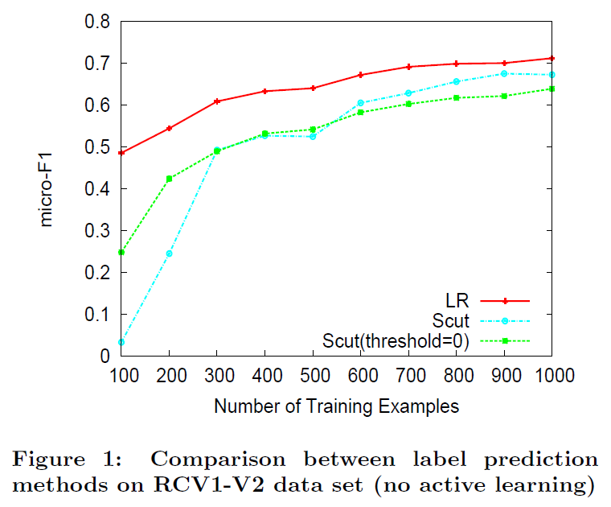
Results cont’s
Compare the labeling methods
  The proposed method
  Scut [D.D. Lewis 04]
    Tune threshold for each class
  Scut (threshold =0)

Slide 20
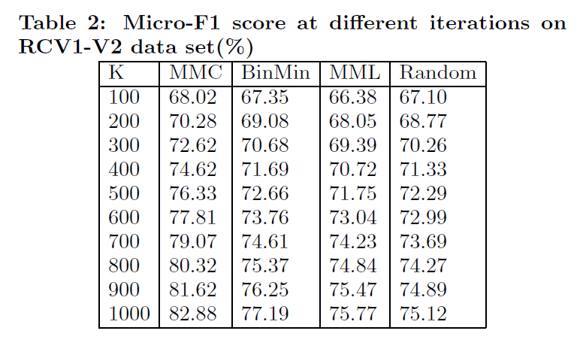
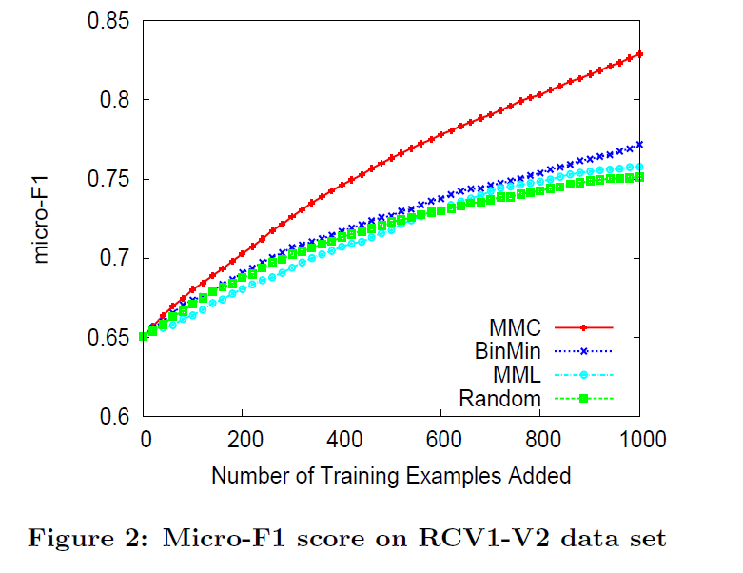
Results cont’s
Initial set: 500 examples
50 iteration, S = 20

Slide 21
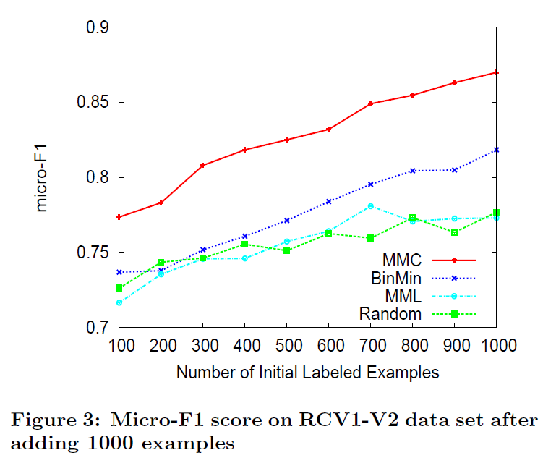
Results cont’s
Vary the size of initial labeled set 50 iterations s=20

Slide 22
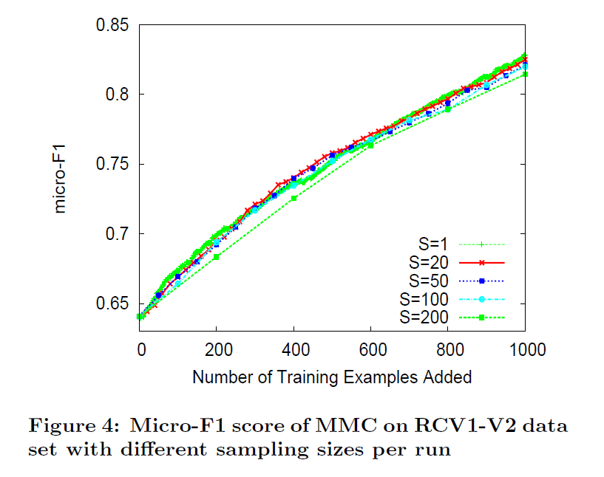
Results cont’s
Vary the sampling size per rum: initial labeled set: 500 examples
Stop after adding 1 000 labeled data

Slide 23
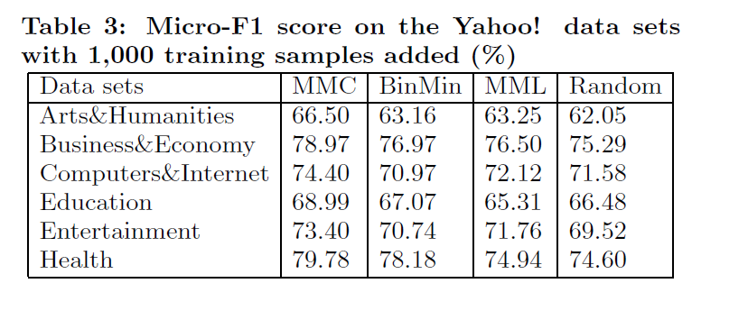
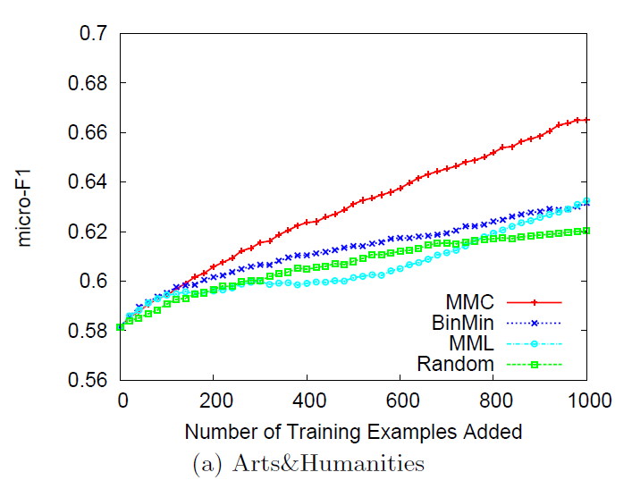
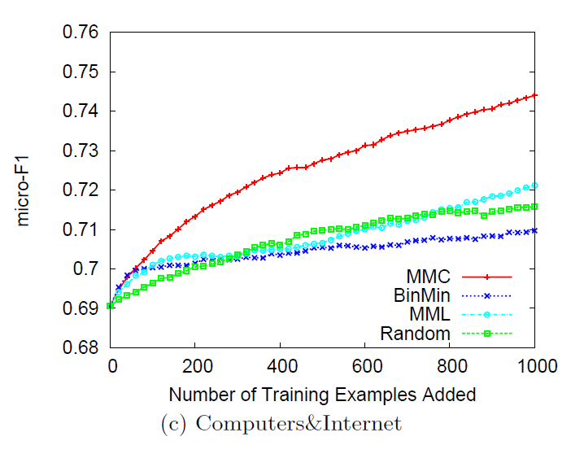
Results cont’s
Initial labeled set: 500 examples
Iterations: 50 s=50

Slide 24
Summary
Multi-Label Active Learning for Text Classification
  Important to reduce human labeling effort
  Challenging tast
SVM-based Multi-Label Active learning
  Optimize loss reduction rate based on SVM version space
  Effective label prediction method
From the results
  Successfully reduce labeling effort on the real world datasets and its better than other methods

Slide 25
Thanks you for listening

